Slide 1
Environmental
Circulating Fluidized Bed Boiler
Dowon SHUN
Korea Institute of Energy Research

Slide 2
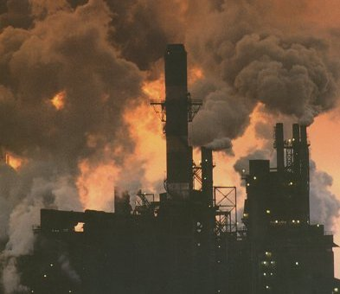
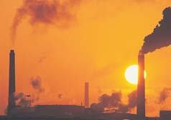
Emisson
Remove toxic waste components before combustion
Apply proper Emission Control Devices

Slide 3
Flue Gas Pollutants
Particulates : Human health harzard
Acid Gases
NO_{x} : Ground level Ozone formation
CO : Toxic gas
SO2 : Acid rain, health hazard
Organic Hazardous Air Pollutants
dioxin
Metallic Hazardous Air Pollutants
Hg

Slide 4
Environmental facilities
Parts | Consideration | Design criteria
Tube coating | Erosion and corrosion protection | Coating, overlay welding
Refractory | Light weight, fire resistant, thermal insulation, crushing strangth | Castable curing
SNCR |  | Mole Ratio Urea/NO : 1~2
SDR |  | Mole Ratio Ca/(S+2Cl) : 1.5 ~4
Dioxine | Active carbon | A/C concentration 80~150mg/Nm3
Particulates control | Local regulation | > 2ton/h 20(12% O2) 200-2ton/h 40[12% O2) (Korean regulation)

Slide 5
Regulations on New and Renewable Energy
2003 Notification in standards of Recycled Plastic Fuel; quality, & usage (Ministry of Environment, Notification 2003-127)
2005.12. Revision on New and Renewable Regulations
Refuse derived solid fuels have been included
2005 Prime ministery; planning and coordination’s counter measure against Kyoto protocol
Expansion of application of New and Renewable Energy Technology
2007. 1. Revision on the Atmospheric Environment Conservation Act
Emission regulation from RDF combustion
2006. 11. Revision of the Law of Savings and Recycling of Resources (MOE Law 20- 3)
Regal status of RDF
2008.1 Ministry of Environment Act 267
Qulity and grade of tire derived fuel
2008.10 Ministry of Environment Act 304
Definition and Wood chip fuel
2008.10 Ministry of Environment Act 305
Usage of waste wood form furniture and construction
2009 Regulation of waste management (Ministry of Environment)
Fluff RDF, Sludge fuel

Slide 6
Incinerator temperature
[Table 9] Article 35 ENFORCEMENT RULE OF THE WASTES CONTROL ACT MOE Waste Control Act 2019.12.31.
General Incinerator; Exit > 850℃, t > 2sec. Retention (SRF is applied this rule)
High temp incinerator Exit > 1100℃ > t > 2 sec. Retention, & required 2nd Chamber

Slide 7
Specifications of Solid Refuse Fuel
일반 고형연료제품［SRF(Solid Refuse Fuel)］
[Table 7] 20-2 Enforcement Rules MOE Act on the promotion of saving and recycling of resources
Specification |  | unit | Molded |  | Not Molded
Size |  | mm | dia | 50 | Width | 50
 |  |  | length | 100 | Depth | 50
Water |  | wt.% | <10 |  | <25
LHV |  | kcal/kg | > 3,500
Ash |  | wt.% | < 20
Cl |  | wt.% | < 2.0
S |  | wt.% | < 0.6
Metal(dried) | Hg | mg/kg | < 1.0
 | Cd |  | < 5.0
 | Pb |  | < 150
 | As |  | < 13.0
- 7 -

Slide 8
Specifications of Bio-Solid Refuse Fuel
바이오 고형연료제품［BIO-SRF(Biomass-Solid Refuse Fuel)］
[Table 7] 20-2 Enforcement Rules MOE Act on the promotion of saving and recycling of resources
Specification |  | unit | Molded |  | Not Molded
Size |  | mm | dia | < 50 | Width | < 120
 |  |  | length | < 100 | Depth | < 120
Water |  | wt.% | <10 |  | <25
LHV |  | kcal/kg | > 3,000
Ash |  | wt.% | < 15
Cl |  | wt.% | < 0.5
S |  | wt.% | < 0.6
Metal(dried) | Hg | mg/kg | < 0.6
 | Cd |  | < 5.0
 | Pb |  | < 100
 | As |  | < 5.0
Specification |  |  | < 70.0
- 8 -

Slide 9
Regulations on SRF Facility and Emission
[Table 8] 16 Enforcement Rules, MOE Act on the Clean air conservation
* 2020. 1. 1. Revision on the Clean Air Conservation Act
The emission regulation of Thermal utilization facility of SRF
Specifications | Limit (12)% O2 | reference
SOx (ppm) | 30 (12) 40 (12) | > 2 ton/h feeding 200~2 ton/h
NOx (ppm) | 70 (12) 80(12) | > 2 ton/h feeding 200~2 ton/h
HCl (ppm) | 15(12) 20(12) | > 2 ton/h feeding 200~2 ton/h
Dioxin (ng-TEQ/㎥N) | 0.1
Particulates (mg/Sm³) | 10(12) 15(12) | > 2 ton/h feeding 200~2 ton/h
Notes:
재활용촉진법 제20조의3에 규정된 “고형연료제품
사용시설”로서는 시멘트 소성로, 전용발전시설 ~~
으로 규정되어 있으며,
배출혀용기준은 Sox 30ppm, Nox 70ppm,
염화수소 20ppm, 다이옥신은 0.1이하고 규정되어
있습니다.

Slide 10
Nitrogen removal
Source removal to avoid fuel NO_{x} production
T < 900C to avoid thermal NO_{x}
DeNox sytems - selective catalytic reaction via injection of ammonia
Selective non catalytic reaction – injection of Urea at the highest temperature zone

Slide 11
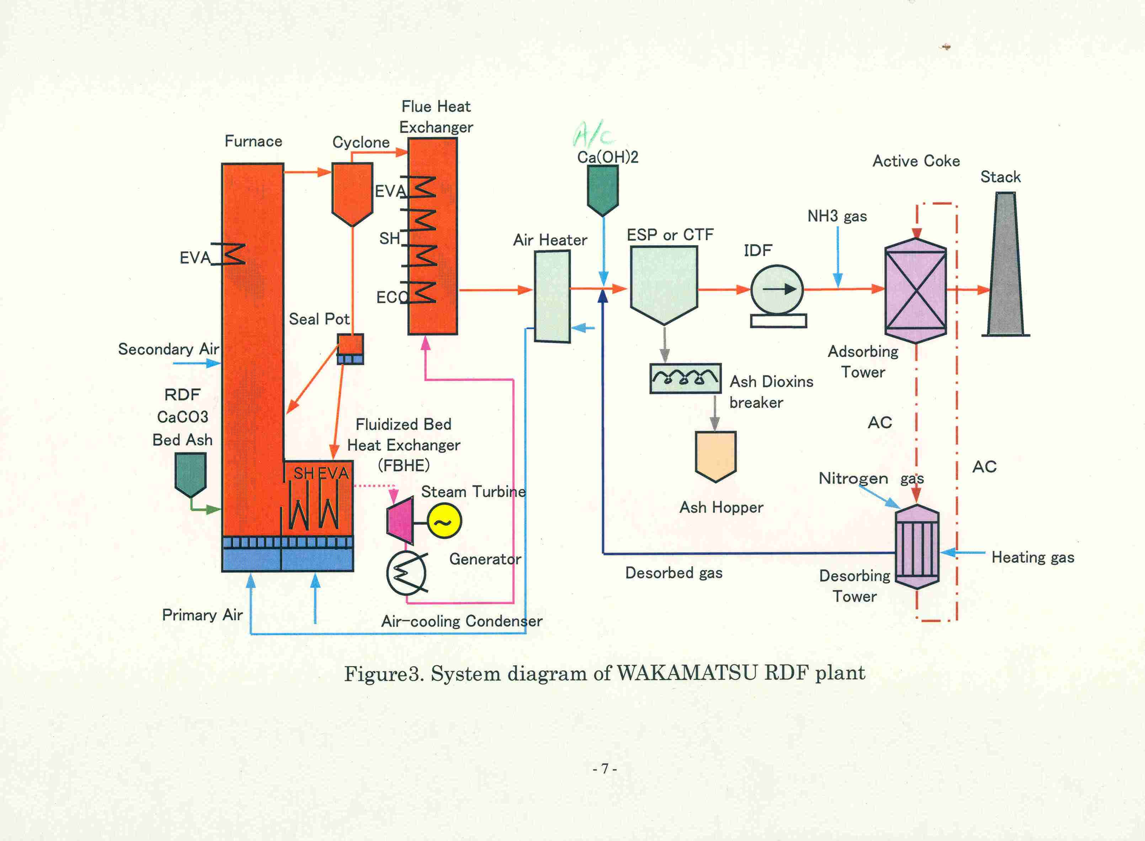
CFBC environmental facility
SNCR

Slide 12
Nox Formation
NO
Char – N
50%
NO
77%
N2
CO, H2, Char
Coal – N
100%
CaO, Char
Volatile – N
50%
NCO
N2O
HCN
O2
N2, NH3

Slide 13
Nox control
Air staging; Maintain Primary air sub-stoichiometric ratio
SNCR(Urea Injection); upgrade atomizer and even distribution of urea mist
SCR;

Slide 14
O2 vs Nox
CEP IIMCFB99, Micro-CFBC Combustion

Slide 15
O2 vs Nox
CEPII Bench97, 0.1MWth CFB combustor

Slide 16
Nox control
4NO + 4NH₃ + O₂ → 4N₂ + 6H₂O
2NO₂ + 4NH₃ + O₂ → 3N₂ + 6H₂O
NO + NO₂ + 2NH₃ → 2N₂ + 3H₂O
4NO + 2(NH₂)₂CO + O₂ → 4N₂ + 4H₂O + 2CO₂

Slide 17
SNCR
Urea injection

Slide 18
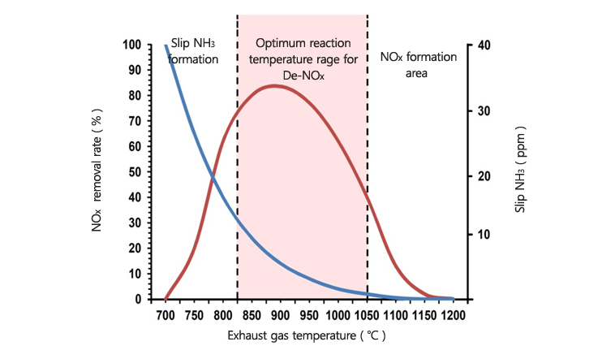
SNCR temperature
Naecheon Inductrial Co., LTD.

Slide 19
SNCR
(NH2)2CO +2NO +1/2O2 → 2N2 + 2H2O +CO2
SNCR injection point

Slide 20
SCR
TiO2, V2O5, MO on Zeolite matrix

Slide 21
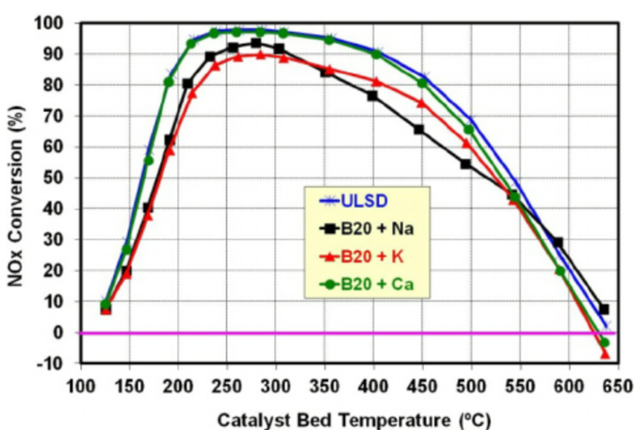
Temperature range
Impact of Fuel Metal Impurities on the Durability of a Light-Duty Diesel Aftertreatment System, SAE Technical Papers, 2013

Slide 22
Location of SCR in Wonju

Slide 23
Acid Gases
From Cl, S, N, Fl in refuse (in plastics, textiles, rubber, yd waste, paper)
Uncontrolled incineration - 18-20% HCl with pH 2
Acid gas scrubber (SO₂, HCl, HFl) usually ahead of ESP or baghouse
Wet scrubber
Spray dryer
Dry scrubber injectors

Slide 24
SO2 absorption I
Formation of Sulfur Dioxide
S + O2 -> SO2 +296 kJ/gmol
Calcination of limestone
CaCO₃ = CaO + CO₂

Slide 25
SO2 absorption II
탈황(석회석 사용)
CaO + SO2 -> CaSO3
CaSO3 + ½ O₂ -> CaSO4
------------------------
CaO + SO₂ + ½ O₂ = CaSO₄

Slide 26
SO2의 제어
순환유동층 보일러 기술-연구개발
석회석 주입
석회석 미주입

Slide 27
Emissions during RDF combustion
O₂ (%) | CO₂ (%) | SO₂ (ppm) | NOx (ppm) | CO (ppm) | HCl (ppm) | TSP (mg/Sm³)
7.3 | 10.1 | 2.5 | 78.2 | 155.9 | 298.3 | 22.4
A typical emission of K RDF(2007.5.20.)

Slide 28
Dry flue gas absorption
SO₂ absorption
SO₂ + Ca(OH)₂ + 1/2O₂ →CaSO₄ + H₂O
HCl absorption
2HCl + Ca(OH)₂ → 2H₂O + CaCl₂

Slide 29
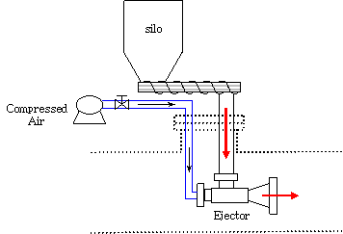
Semi Dry Reactor

Slide 30
Wet flue gas scrubbing
SO₂ + CaCO3 + 1/2O₂ + 2H₂O
→CaSO₄ 2 H₂O + CO2

Slide 31
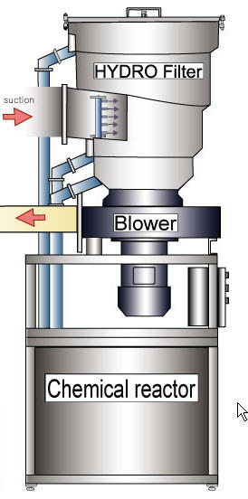
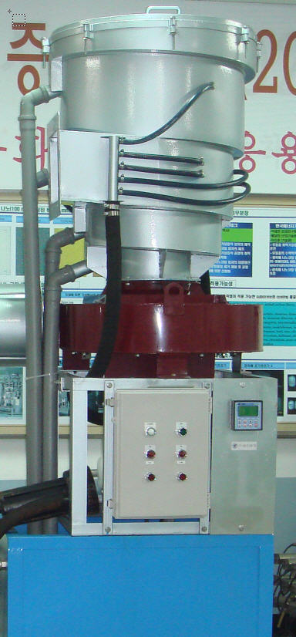
High efficiency Hydro-filter for HCl capture
HCl Capture efficiency
pH [ppm] | Cl(in) [ppm] | Cl(out) [ppm] | Removal [%]
2.2 | 500 | 7 | 98.6
7.2 | 600 | 10 | 98.3
7.4 | 550 | 5 | 99.0
9.6 | 500 | 4 | 99.2
Tangential admission of flue gas and chemicals increase the capture efficiency
The capacity of this unit: 8,000 Nm3/hr
31

Slide 32
Dioxines

Slide 33
Dioxin 저감 기술
생 성
억 제
최적연소조업
De-novo 합성에 의한 생성 억제
생성억제제 투입
Dioxin 생성 억제제(Inhibitor)를 원료와 함께 투입
흡 착
제 거
습식 세정
배기 가스를 급격히 75℃ 이하로 냉각 후 제진
흡착탑 흡착
흡착제가 충진 된 흡착탑을 통과시켜 제거
흡착제 살포
미세 흡착제를 배기 가스에 뿌려서 제거 후 집진
분 해
제 거
촉매 분해
촉매가 coating된 충진재를 이용한 산화반응
고온 소각
1000℃ 이상의 고온조건 하에서 소각처리
광 분해
자외선(290~320nm) 에너지를 이용해 분해

Slide 34
요소주입에 의한 다이옥신 생성억제 Mechanism

Slide 35
활성탄 투입
Convection pass
A/C Silo
Distributor
Flue gas
E.P.
I.D. FAN
Stack

Slide 36
Emission control facilities
De Nox
Air staging, SNCR
SCR
SO2 absorption
Limestone injection
FGD
Dioxin removal
Activated Carbon Injection

Slide 37
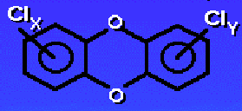
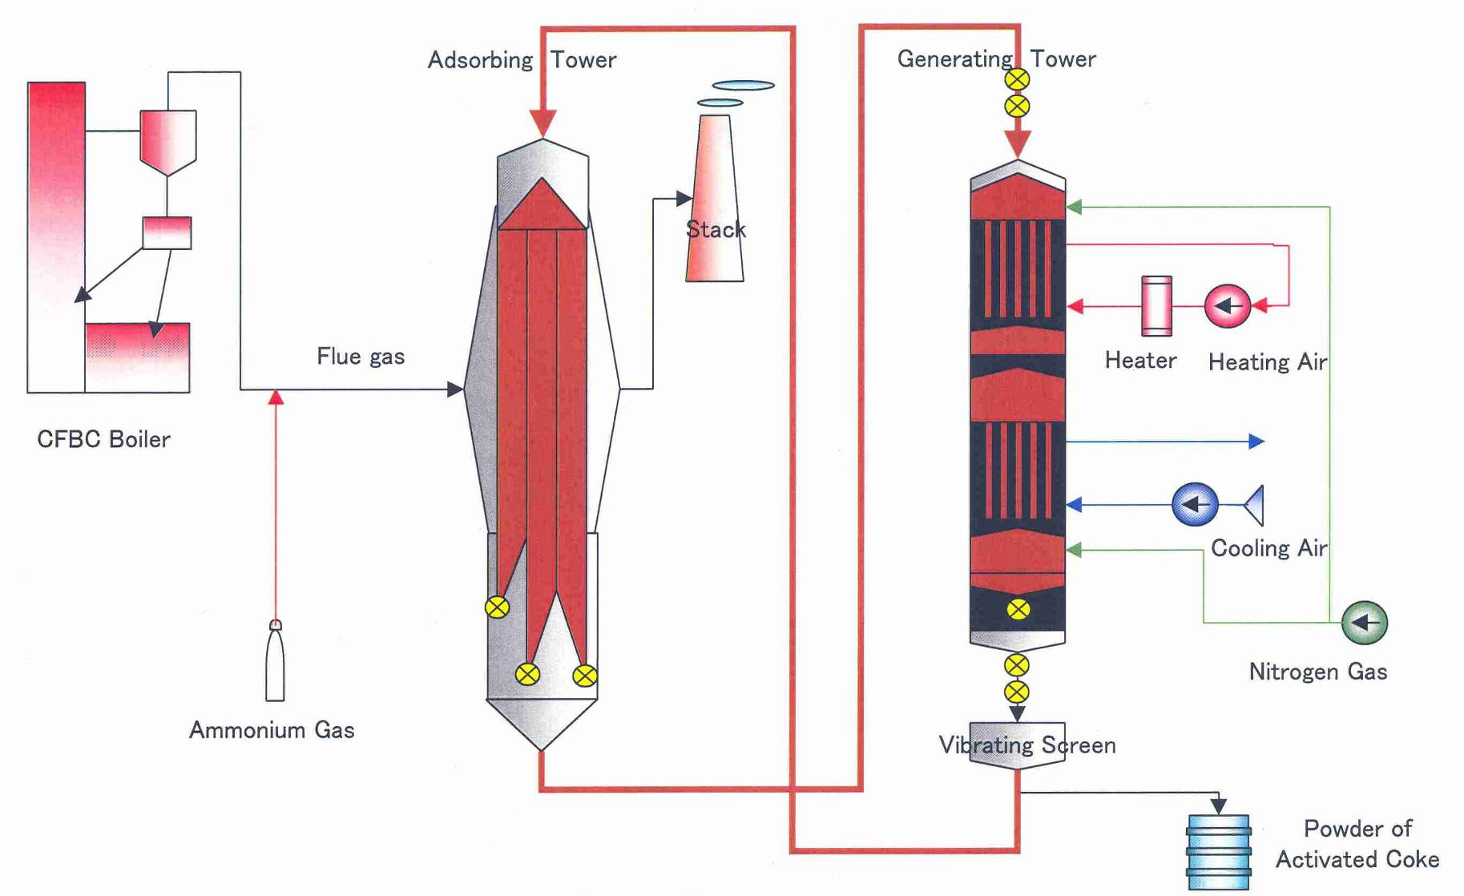
Dioxin

Slide 38
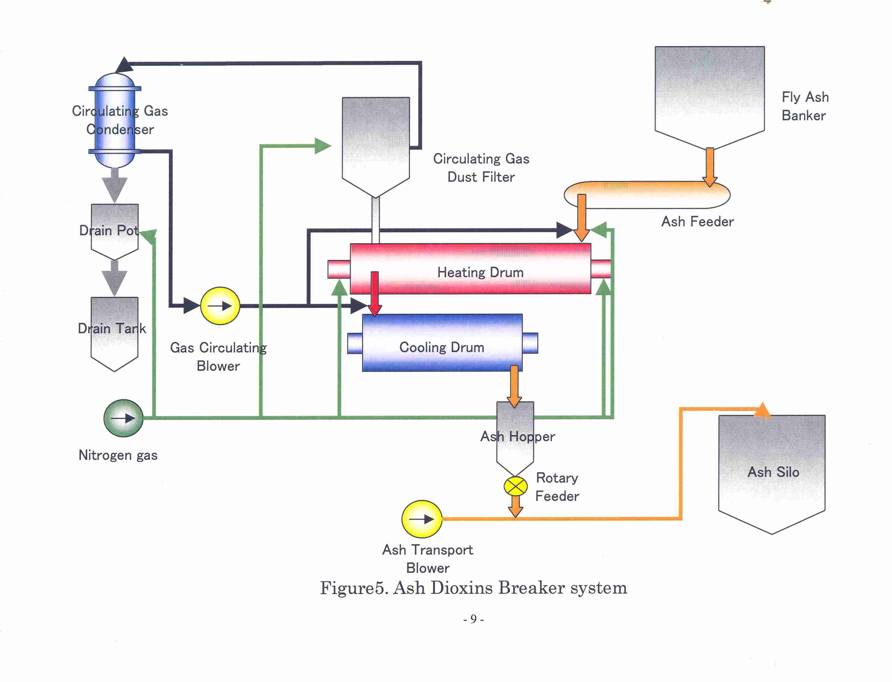
Dioxine breaker system

Slide 39
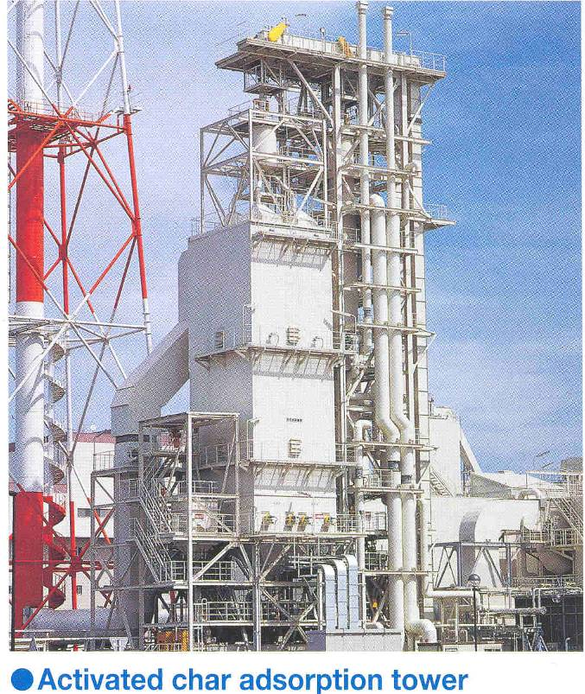
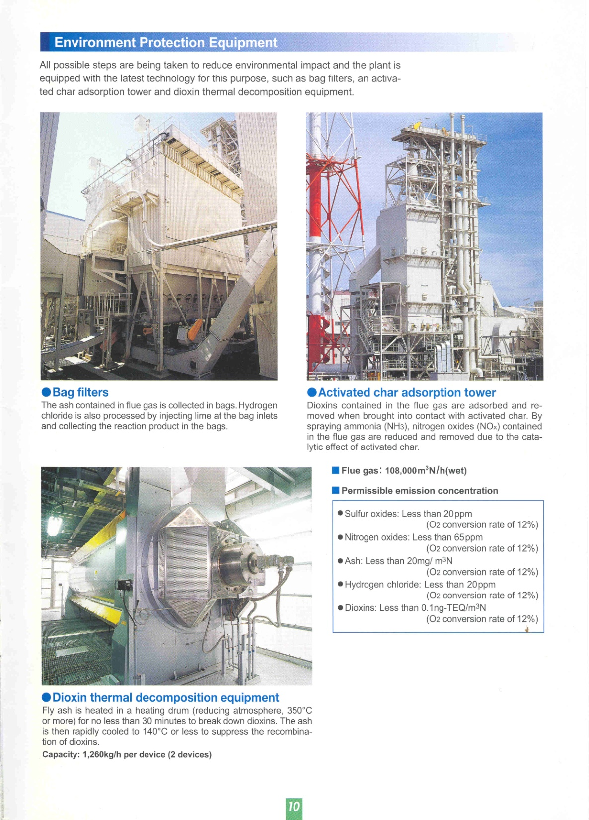
Dioxin control

Slide 40
Particulates
Incombustible minerals
Condensable hydrocarbon
Too low of Temperature (incomplete comb)
Insufficient or too much air
Insufficient mixing or residence time
Too much turbulence, entrainment of particulates
Control
Improve combustion to minimize the unburned hydrocarbon
Collect by Cyclones (not effective for removal of small particulates)
Finally by Electrostatic precipitator or by Fabric Filters (bag houses)

Slide 41
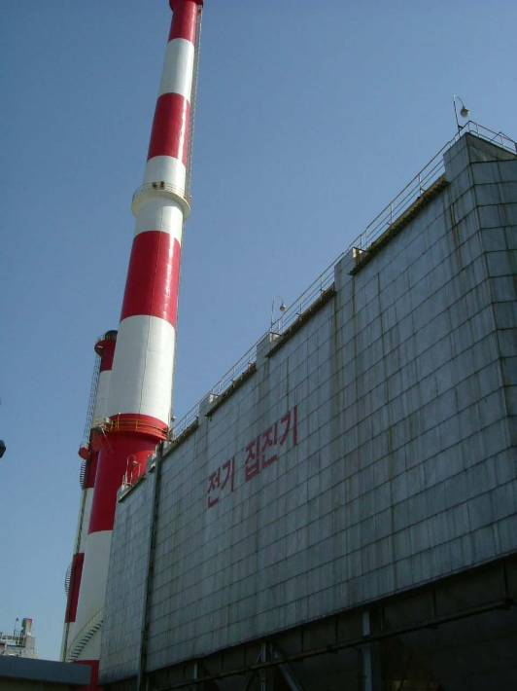
Particulates control system
Electrostatic precipitator
Bag house

Slide 42
Bag filter
0.25
0.25 x 20 = 5
0.25 x 10 =2.5

Slide 43
Bag filter

Slide 44
Selected stack height(Hs)
0.65(Hm+Ht)
He
Hs
Xmax
Cm

Slide 45
Effected stack height(He)
He = Hs + 0.65 x (Hm +Ht)
He = Hs + Vs x d/u
Selected
Buoyancy
Kinetic
Srack gas velocity
Stack I.D./environment air velocity

Slide 46
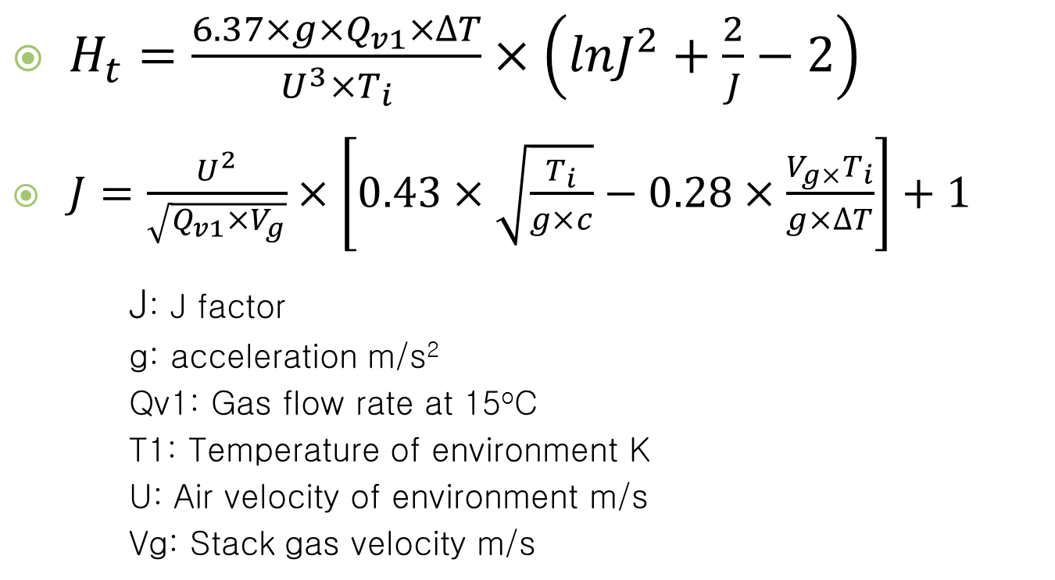
Buoyancy height(Ht)
$H_{t}=\frac{6.37×g×Q_{v1}×∆T}{U^{3}×T_{i}}×\left(lnJ^{2}+\frac{2}{J}−2\right)$
$J=\frac{U^{2}}{\sqrt{Q_{v1}×V_{g}}}×\left[0.43×\sqrt{\frac{T_{i}}{g×c}}−0.28×\frac{V_{g×}T_{i}}{g×∆T}\right]+1$
J: J factor
g: acceleration m/s²
Qv1: Gas flow rate at 15ºC
T1: Temperature of environment K
U: Air velocity of environment m/s
Vg: Stack gas velocity m/s

Slide 47

Kinetic height(Hm)
$H_{m}=\frac{4.77}{1+0.43×U/{V_{g}}}$
U: Air velocity of environment m/s
Vg: Stack gas velocity m/s

Slide 48

Maximum landing distance(Xmax)
$X_{max}={\left(\frac{H_{e}}{C_{z}}\right)}^{2/{(2−z)}}$
Cz: Vertical diffusion coeff. 0.07
Z: 0.25

Slide 49

Maximum concentration at landing (Cmax)
$C_{max}=\frac{2×Q_{vi}×{10}^{9}}{π×e×U×{H_{e}}^{2}}×\left(\frac{C_{z}}{C_{x}}\right)$ [ppb]
Cx: Horizontal diffusion coeff. 0.47
Cz: Vertical diffusion coeff. 0.07
e: Natural log 2.72

Slide 50
감사합니다.

